Slide 1


Data Structure
Course Code : ENCS205
Dr Swati Gupta
Associate Professor, School of Engineering & Technology
K.R. Mangalam University
Unit 4 :Trees and Graphs
Notes:
New Courses replaced with New Programmes

Slide 2
Breadth-First Search (BFS)

Slide 3
Breadth-First Search (BFS)
We always start with source node.
QUEUE is being used for intermediate operation
Until the Queue becomes Empty we will processed the nodes by removing the front element of Queue

Slide 4
Breadth-First Search (BFS)
Not discovered
white
u
0
∞
x
Discovered,
nodes
gray
v
∞
∞
y
Finished nodes
black
w
∞
∞
z

Slide 5
Breadth-First Search (BFS)
u
0
∞
x
BFS(G, u):
1. Initialize the graph
color[u] ⬅ gray
π[u] ⬅ Nil
d[u] ⬅ 0
for each other vertex
color[u] ⬅ white
v
∞
∞
y
w
∞
∞
z

Slide 6
Breadth-First Search (BFS)
u
0
∞
x
Q
u
BFS(G, u):
2. Initialize the queue
Q ⬅ Ø
Enqueue(Q, u)
v
∞
∞
y
w
∞
∞
z

Slide 7
Breadth-First Search (BFS)
t = u
r = v, x
u
0
1
x
Q
v
x
BFS(G, u):
3. While Q ≠ Ø
2) for each r adj to t
if color[r] = white
color[r] ⬅ gray
π[r] ⬅ t
d[r] ⬅ d[t] + 1
Enqueue(Q, r)
v
1
∞
y
w
∞
∞
z

Slide 8
Breadth-First Search (BFS)
t = u
u
0
∞
x
Q
BFS(G, u):
3. While Q ≠ Ø
1) t ⬅ Dequeue(Q)
v
∞
∞
y
w
∞
∞
z

Slide 9
Breadth First Search
We always start with source node
Data Structure QUEUE is being used for intermediate operation
Until the Queue becomes Empty we will processed the nodes by removing the front element of Queue

Slide 10
Breadth-First Search (BFS)
Not discovered
white
u
0
∞
x
Discovered,
nodes
gray
v
∞
∞
y
Finished nodes
black
w
∞
∞
z

Slide 11
Breadth-First Search (BFS)
u
0
∞
x
BFS(G, u):
1. Initialize the graph
color[u] ⬅ gray
π[u] ⬅ Nil
d[u] ⬅ 0
for each other vertex
color[u] ⬅ white
v
∞
∞
y
w
∞
∞
z

Slide 12
Breadth-First Search (BFS)
u
0
∞
x
Q
u
BFS(G, u):
2. Initialize the queue
Q ⬅ Ø
Enqueue(Q, u)
v
∞
∞
y
w
∞
∞
z

Slide 13
Breadth-First Search (BFS)
t = u
u
0
∞
x
Q
BFS(G, u):
3. While Q ≠ Ø
1) t ⬅ Dequeue(Q)
v
∞
∞
y
w
∞
∞
z

Slide 14
Breadth-First Search (BFS)
t = u
r = v, x
u
0
1
x
Q
v
x
BFS(G, u):
3. While Q ≠ Ø
2) for each r adj to t
if color[r] = white
color[r] ⬅ gray
π[r] ⬅ t
d[r] ⬅ d[t] + 1
Enqueue(Q, r)
v
1
∞
y
w
∞
∞
z

Slide 15
Breadth-First Search (BFS)
t = u
r = x, v
u
0
1
x
Q
v
x
BFS(G, u):
3. While Q ≠ Ø
3) color[t] ⬅ black
v
1
∞
y
w
∞
∞
z

Slide 16
Breadth-First Search (BFS)
t = v
u
0
1
x
Q
x
BFS(G, u):
3. While Q ≠ Ø
1) t ⬅ Dequeue(Q)
2) for each r adj to t
…
3) color[t] ⬅ black
v
1
∞
y
w
∞
∞
z

Slide 17
Breadth-First Search (BFS)
t = v
r = y
u
0
1
x
Q
x
y
BFS(G, u):
3. While Q ≠ Ø
1) t ⬅ Dequeue(Q)
2) for each r adj to t
…
3) color[t] ⬅ black
v
1
2
y
w
∞
∞
z

Slide 18
Breadth-First Search (BFS)
t = v
r = y
u
0
1
x
Q
x
y
BFS(G, u):
3. While Q ≠ Ø
1) t ⬅ Dequeue(Q)
2) for each r adj to t
…
3) color[t] ⬅ black
v
1
2
y
w
∞
∞
z

Slide 19
Breadth-First Search (BFS)
t = x
r =
u
0
1
x
Q
y
BFS(G, u):
3. While Q ≠ Ø
1) t ⬅ Dequeue(Q)
2) for each r adj to t
…
3) color[t] ⬅ black
v
1
2
y
w
∞
∞
z

Slide 20
Breadth-First Search (BFS)
t = y
r = w
u
0
1
x
Q
w
BFS(G, u):
3. While Q ≠ Ø
1) t ⬅ Dequeue(Q)
2) for each r adj to t
…
3) color[t] ⬅ black
v
1
2
y
w
3
∞
z

Slide 21
Breadth-First Search (BFS)
t = w
r = z
u
0
1
x
Q
z
BFS(G, u):
3. While Q ≠ Ø
1) t ⬅ Dequeue(Q)
2) for each r adj to t
…
3) color[t] ⬅ black
v
1
2
y
w
3
4
z

Slide 22
Breadth-First Search (BFS)
t = z
r =
u
0
1
x
Q
BFS(G, u):
3. While Q ≠ Ø
1) t ⬅ Dequeue(Q)
2) for each r adj to t
…
3) color[t] ⬅ black
v
1
2
y
w
3
4
z

Slide 23
Breadth-First Search (BFS)
u
0
1
x
BFS(G, u):
- the shortest-path distance
from u
v
1
2
y
w
3
4
z

Slide 24
Breadth-First Search (BFS)
u
0
1
x
BFS(G, u):
- the shortest-path distance
from u
- construct a tree
v
1
2
y
w
3
4
z

Slide 25
Breadth-First Search (BFS)
u
0
1
x
BFS(G, u):
- Initialization: |V|
- Enqueuing/dequeuing:
|V|
- Scanning adj vertices: |E|
v
1
2
y
w
3
4
z

Slide 26
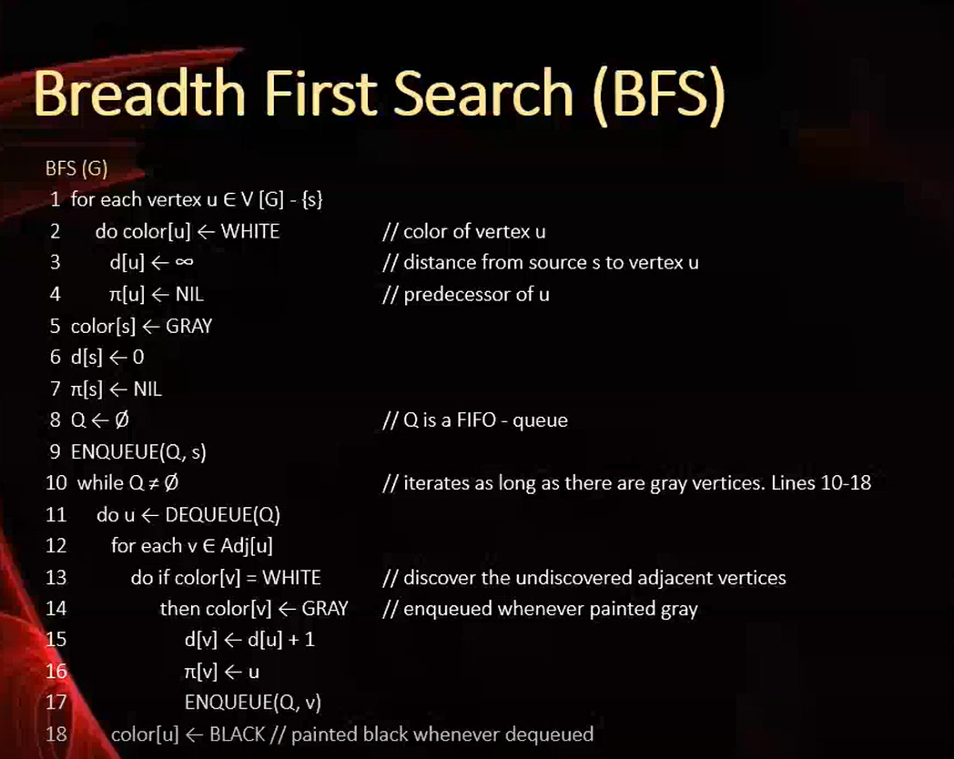
Graph coloring Algorithm (BFS)

Slide 27
Depth-First Search (DFS)

Slide 28
Depth-First Search (DFS)
Not discovered(white)
u
x
Discovered,
Nodes(Grey)
d /
v
y
Finished nodes(Black)
d / f
w
z

Slide 29

Parameters Used
Parent of a Node u
d(u)-------discover time of node u
f(u)------finishing time of node u(when it is finished)//Black

Slide 30
Depth-First Search (DFS)
d[u]: when u is discovered
f[u]: when searching adj of u
is finished
u
v
w

Slide 31
Depth-First Search (DFS)
timestamp: t
d[u]: when u is discovered
f[u]: when searching adj of u
is finished
d[u] = t
u
v
w

Slide 32
Depth-First Search (DFS)
timestamp: t+1
d[u]: when u is discovered
f[u]: when searching adj of u
is finished
d[u] = t
u
v
w
d[v] = t+1

Slide 33
Depth-First Search (DFS)
timestamp: t+2
d[u]: when u is discovered
f[u]: when searching adj of u
is finished
d[u] = t
u
v
w
d[v] = t+1
f[v] = t+2

Slide 34
Depth-First Search (DFS)
timestamp: t+3
d[u]: when u is discovered
f[u]: when searching adj of u
is finished
d[u] = t
u
v
w
d[v] = t+1
f[v] = t+2
d[w] = t+3

Slide 35
Depth-First Search (DFS)
timestamp: t+4
d[u]: when u is discovered
f[u]: when searching adj of u
is finished
d[u] = t
u
v
w
d[v] = t+1
f[v] = t+2
d[w] = t+3
f[v] = t+4

Slide 36
Depth-First Search (DFS)
timestamp: t+5
d[u]: when u is discovered
f[u]: when searching adj of u
is finished
d[u] = t
f[u] = t+5
u
v
w
Remember: Output of DFS is always forest. Forest---Collection of trees
d[v] = t+1
f[v] = t+2
d[w] = t+3
f[w] = t+4

Slide 37
Depth-First Search (DFS)
u
x
DFS(G):
1. Initialization
for each u V[G],
color[u] ⬅ white
π[u] ⬅ Nil //
time ⬅ 0
v
y
Parent is nil
w
z

Slide 38
Depth-First Search (DFS)
u
1/
x
DFS(G):
1. Initialization
2. For each u V[G]
if color[u] = white
DFS-Visit(u)
v
y
DFS-Visit(u):
1. Initial Setting
color[u] ⬅ gray
d[u] ⬅ time ⬅ time + 1
w
z

Slide 39
Depth-First Search (DFS)
u
1/
x
DFS(G):
1. Initialization
2. For each u V[G]
if color[u] = white
DFS-Visit(u)
v
2/
y
DFS-Visit(u):
1. Initial Setting
2. for each adj v of white
π[v] ⬅ u
DFS-Visit[v]
w
z

Slide 40
Depth-First Search (DFS)
u
1/
x
DFS(G):
1. Initialization
2. For each u V[G]
if color[u] = white
DFS-Visit(u)
v
2/
3/
y
DFS-Visit(u):
1. Initial Setting
2. for each adj v of white
π[v] ⬅ u
DFS-Visit[v]
w
z

Slide 41
Depth-First Search (DFS)
u
1/
4/
x
DFS(G):
1. Initialization
2. For each u V[G]
if color[u] = white
DFS-Visit(u)
v
2/
3/
y
DFS-Visit(u):
1. Initial Setting
2. for each adj v of white
π[v] ⬅ u
DFS-Visit[v]
w
z

Slide 42
Depth-First Search (DFS)
u
1/
4/5
x
DFS(G):
1. Initialization
2. For each u V[G]
if color[u] = white
DFS-Visit(u)
v
2/
3/
y
DFS-Visit(u):
1. Initial Setting
2. Handling adj vertices
3. color[u] ⬅ black
f[u] ⬅ time ⬅ time + 1
w
z

Slide 43
Depth-First Search (DFS)
u
1/
4/5
x
DFS(G):
1. Initialization
2. For each u V[G]
if color[u] = white
DFS-Visit(u)
v
2/
3/6
y
DFS-Visit(u):
1. Initial Setting
2. Handling adj vertices
3. color[u] ⬅ black
f[u] ⬅ time ⬅ time + 1
w
z

Slide 44
Depth-First Search (DFS)
u
1/
4/5
x
DFS(G):
1. Initialization
2. For each u V[G]
if color[u] = white
DFS-Visit(u)
v
2/7
3/6
y
DFS-Visit(u):
1. Initial Setting
2. Handling adj vertices
3. color[u] ⬅ black
f[u] ⬅ time ⬅ time + 1
w
z

Slide 45
Depth-First Search (DFS)
u
1/8
4/5
x
DFS(G):
1. Initialization
2. For each u V[G]
if color[u] = white
DFS-Visit(u)
v
2/7
3/6
y
DFS-Visit(u):
1. Initial Setting
2. Handling adj vertices
3. color[u] ⬅ black
f[u] ⬅ time ⬅ time + 1
w
z

Slide 46
Depth-First Search (DFS)
u
1/8
4/5
x
DFS(G):
1. Initialization
2. For each u V[G]
if color[u] = white
DFS-Visit(u)
v
2/7
3/6
y
DFS-Visit(u):
1. Initial Setting
2. Handling adj vertices
3. color[u] ⬅ black
f[u] ⬅ time ⬅ time + 1
w
9/
z

Slide 47
Depth-First Search (DFS)
u
1/8
4/5
x
DFS(G):
1. Initialization
2. For each u V[G]
if color[u] = white
DFS-Visit(u)
v
2/7
3/6
y
DFS-Visit(u):
1. Initial Setting
2. Handling adj vertices
3. color[u] ⬅ black
f[u] ⬅ time ⬅ time + 1
w
9/
10/
z

Slide 48
Depth-First Search (DFS)
u
1/8
4/5
x
DFS(G):
1. Initialization
2. For each u V[G]
if color[u] = white
DFS-Visit(u)
v
2/7
3/6
y
DFS-Visit(u):
1. Initial Setting
2. Handling adj vertices
3. color[u] ⬅ black
f[u] ⬅ time ⬅ time + 1
w
9/
10/11
z

Slide 49
Depth-First Search (DFS)
u
1/8
4/5
x
DFS(G):
1. Initialization
2. For each u V[G]
if color[u] = white
DFS-Visit(u)
v
2/7
3/6
y
DFS-Visit(u):
1. Initial Setting
2. Handling adj vertices
3. color[u] ⬅ black
f[u] ⬅ time ⬅ time + 1
w
9/12
10/11
z

Slide 50
Depth-First Search (DFS)
u
1/8
4/5
x
DFS(G):
- construct a forest
v
2/7
3/6
y
w
9/12
10/11
z

Slide 51
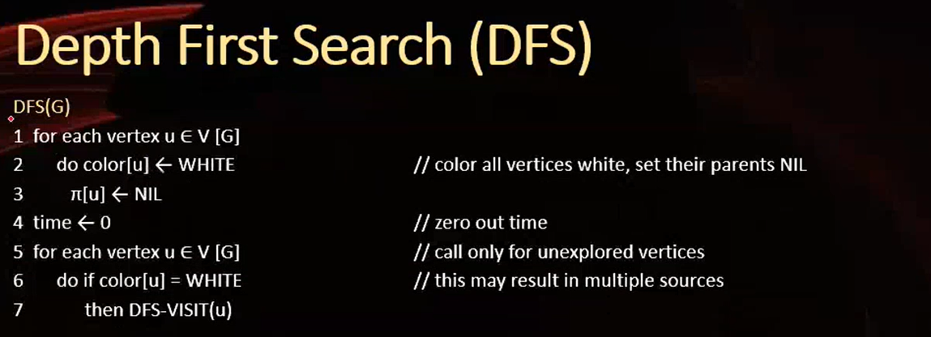
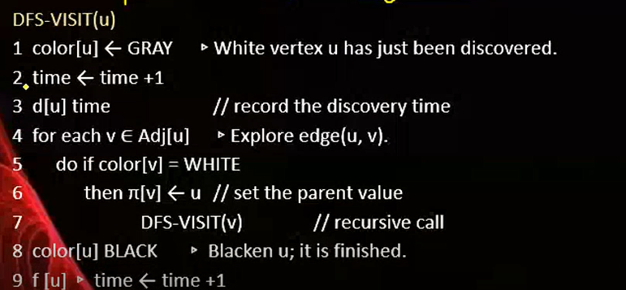
DFS Algorithm

Slide 52
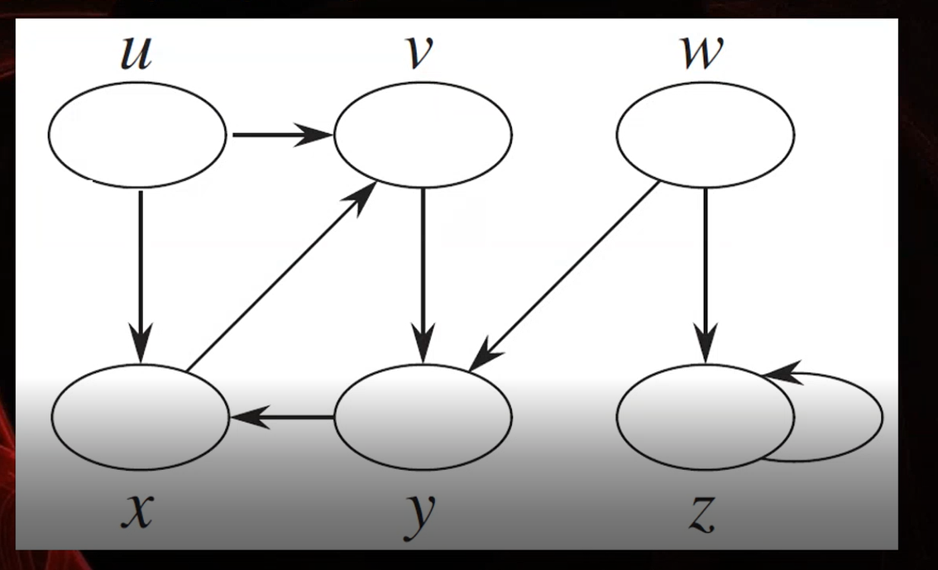
Exercise Problem

Slide 53

References
https://www.boardinfinity.com/blog/graphs/.
https://www.geeksforgeeks.org/what-is-graph-data-structure/
https://www.tutorialspoint.com/data_structures_algorithms/graph_data_structure.html.
https://www.simplilearn.com/tutorials/data-structure-tutorial/graphs-in-data-structure
https://www.geeksforgeeks.org/applications-of-graph-/
https://www.upgrad.com/blog/graphs-in-data-structure/
https://www.youtube.com/watch?v=4IZ80K72OXo
Notes:
New Courses replaced with New Programmes

Slide 54

THANK YOU

